Slide 1
DELE ca2 Part A cifar 10 gan
Jayden Yap Jean Hng p2112790
DAAA/2B/04
Contents:
CIFAR Dataset
Baseline DCGAN
DCGAN Improvement I
DCGAN Improvement II
Conditional DCGAN
Wasserstein’s Loss GAN (WGAN)
Hyperparameter tuning on DCGAN

Slide 2
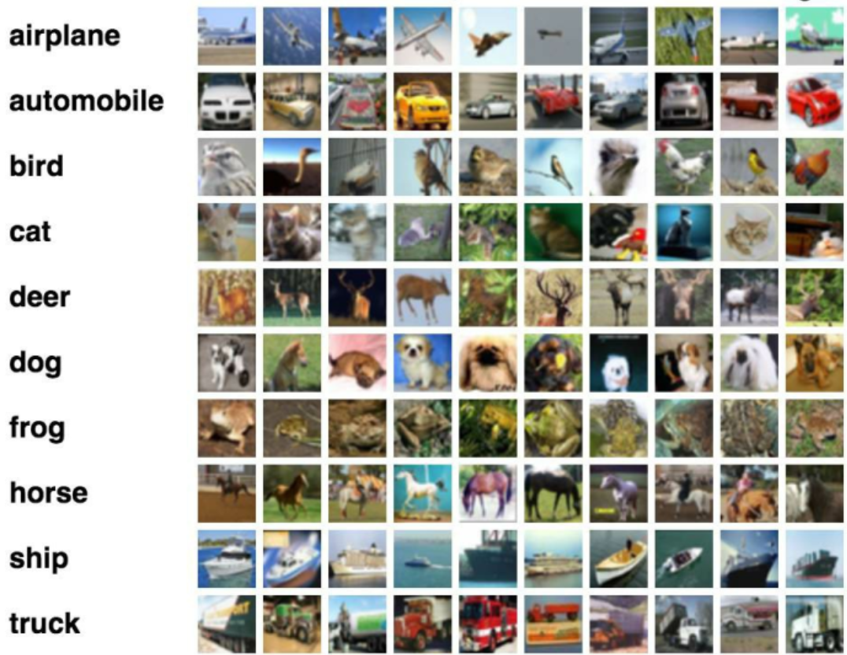
Image generation task: cifar 10 dataset
60,000 total images
32 x 32 pixels x 3 channels (RGB) (total 3072 elements)
10 classes
Train-test split
10 000 test images
50 000 training images
Because this is unsupervised learning, we can combine the 2 sets for increased amount of data
We will evaluate our models with Frechet Inception Distance:
Evaluates distribution of generated images by comparing with real ground truth images using Inception model
Popular metric for evaluation used by many academic research papers

Slide 3
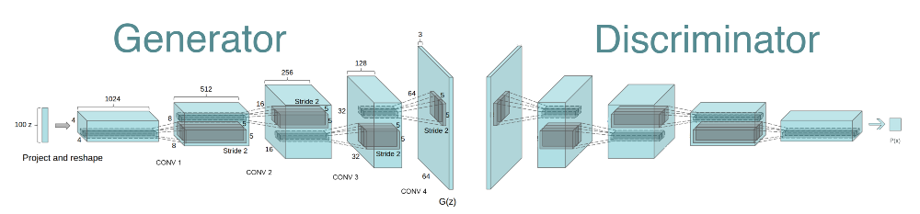

Baseline dcgan
Deep Convolutional Generative Adversarial Networks (DCGAN) is a variant of GANs where the generator and discriminator networks are composed of convolutional layers.
Proposed in 2016
Used to generate high-quality images, such as faces and realistic landscapes
Discriminator Architecture (more like conventional CNN)
Input is image (either real or generated)
Dense (linear layer) 2048 neurons
4x Convulution layers 64 neurons each, stride 3x to downsample from 32x32 to 4x4
Flatten the inputs
Output Dense layer with 1 neuron, outputs the final prediction for real/fake image (sigmoid activation)
64
32
64
64
Total trainable parameters combined: 584,516
Very basic model that may do well on simple datasets like MNIST but not do so well on a more complex dataset like CIFAR
32
Generator Architecture
Input of random noise (100 latent dimensions)
Dense (linear layer) 2048 neurons
3x Convulution Transpose layers 64 neurons each, stride to upsample image size by 2x from 4x4 to 32x32
Output Conv layer with 3 channels, outputs the final generated image
Activations: LeakyReLU for Convolutions and tanh for output
Notes:
Convolution: Contains a set of filters (a.k.a kernels) with parameters to be trained
The filters go through the images and creates activation maps (mapping out the features)
Batch Normalisation: Tackles the issue of Internal Covariate Shift
Inputs to a neuron are always changing each epoch
Learning is bottlenecked in deep networks
Max Pooling: Pooling is required to down sample the detection of features in feature maps
Dropout: Randomly drop/ignore some layer outputs , Reduces overfitting

Slide 4
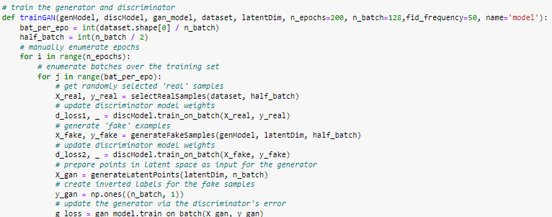
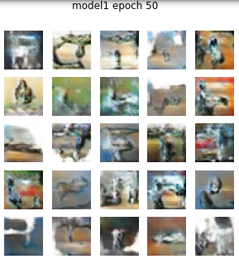
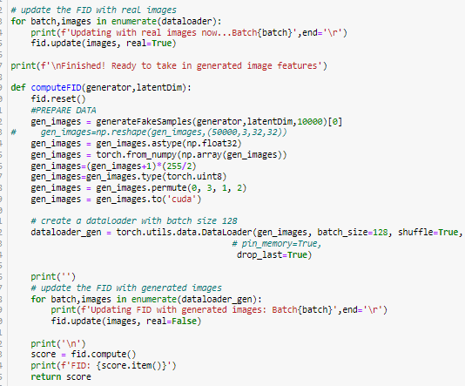
Training results
Results:
Achieved 74 FID score after 50 epochs with 256 batch size
Long 'noisy' phase where generated images are just random patterns
A lot of room to improve because the model was running into mode collapse as well (model creating variants of same image/pattern)
Training loop:
For every step:
1. train disc on real images
2. train disc on generated images
3. train generator and update losses
FID Computation:
Use pytorch metrics library
Faster and more efficient as calculation done in batches
Only calculate the real images’ features once
Calculate generated images’ features in batches during training every ‘X’ epochs
Custom functions proved to be much slower and less practical
During training, compute on 10K test images, for testing stage, compute on total 60K dataset (same as what we trained on)
More accurate way to calculate FID, but during training save computation time
Notes:
Convolution: Contains a set of filters (a.k.a kernels) with parameters to be trained
The filters go through the images and creates activation maps (mapping out the features)
Batch Normalisation: Tackles the issue of Internal Covariate Shift
Inputs to a neuron are always changing each epoch
Learning is bottlenecked in deep networks
Max Pooling: Pooling is required to down sample the detection of features in feature maps
Dropout: Randomly drop/ignore some layer outputs , Reduces overfitting

Slide 5
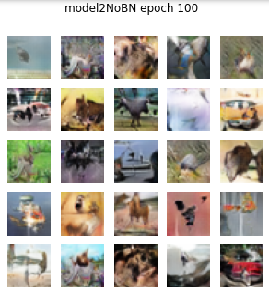
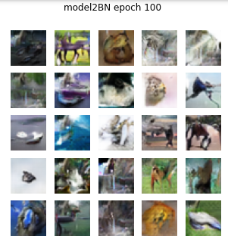
Improvements 1 (model 2)
1. More epochs (100 instead of 50)
2. Improved and more complex models
More neurons in our convolutions will increase amount of information learned
Now 1,335,748 total parameters (more than 2x complexity)
3. Lower batch size to 64 instead of 256
Higher batch size has been shown to disrupt the balance in GANs between discriminator and generator
4. Try model with and without batch normalisation
Batch normalisation has shown to be a hit or miss depending on architecture and dataset, we will test both with and without
Results
Improved FID from 74:
Without batch normalisation: to 43 FID
With batch normalisation: to 39 FID
Now we can start to recognize the classes in some images, like horse etc, however sometimes the shapes/objects are obsecure
I believe this is a significant enough improvement to say that batch normalisation will be good to use for my future DCGAN models

Slide 6
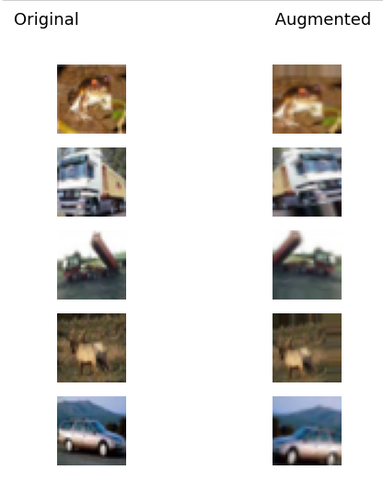
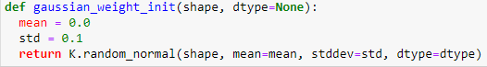
Improvements 2 (model 3)
1. Image data generator
Create a new set of images that are augmented from training images. In total, we will have double the amount of images. This will help our future models to have better accuracy
Reduce overfitting, increase robustness due to model seeing more variants of similar images
Randomly Flip, Rotate, Translate, Zoom images
Do light augmentation: Too much can cause the generator to learn the distribution of Augmented images more than the real images. E.g. use of random erasing can cause distortion in generated images
2. Label smoothing
Instead of binary 0,1 labels, we smooth the positive (1) labels over a range between 0.9 and 1.0
Counters the issue of discriminator being too overconfident in predictions, therefore improving stability
3. Gaussian Weight Initialisation
Initialise weights with a normal (gaussian) distribution. (Mean 0 STD 0.1)
Shown to be effective on GANs to prevent mode collapse especially at the beginning (hence weight initialization)

Slide 7
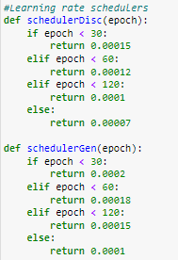
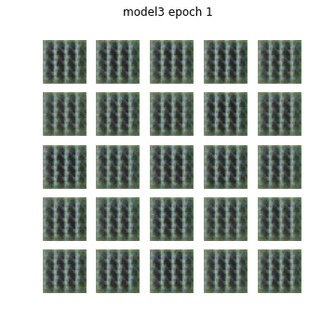
Improvements 2 (model 3) continued
4. Learning Rate Scheduler
Change learning rate of discriminator and generator over time during training
High learning rate at start to converge faster, then slower learning rate for fine tuning in later epochs
5. Fixed seed evaluation
When visualizing generated images we use the same latent seed each time so we can better see the progress the model over the course of training
This allows us to create a animation like shown that can show how our model refines the shapes of objects in the images over time as it learns more detailed features
Does not affect learning just our evaluation
Using same model architecture
Results:
Improved FID from 39 to 32

Slide 8
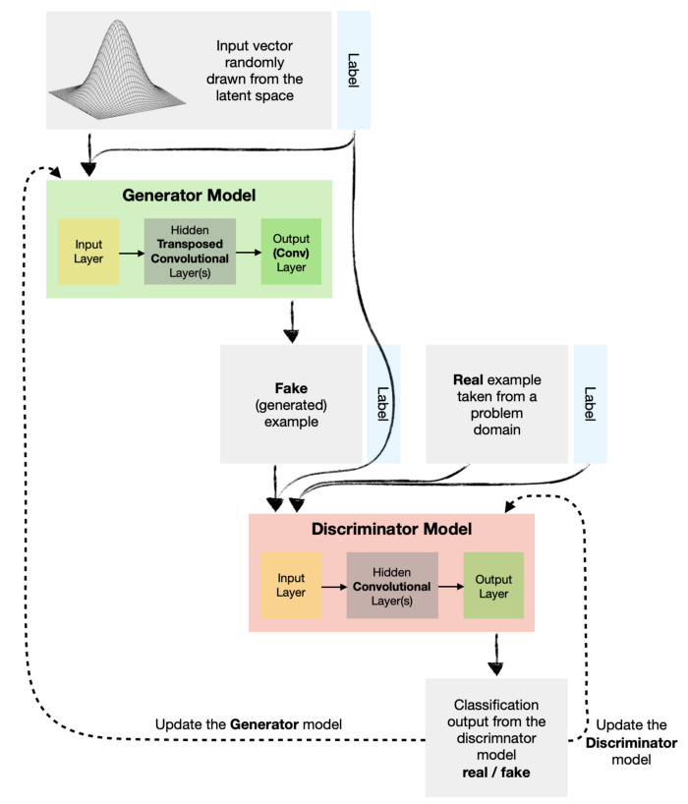
Conditional dcgan
In a real life scenario being able to generate a random image from such a broad dataset like CIFAR10 is not very useful. If we can specify which class we want to generate like a car or a plane, that will become more useful
Conditional DCGAN is a variant of DCGANs that generates new data samples based on a given condition, such as in this case, class labels.
Increased complexity and difficulty of training
Architecture
Generator Input: Random noise (100 latent dimensions) + one-hot encoded class labels(0-9), outputs 32x32x3 image
Discriminator Input: 32x32x3 images with labels
Similar high level architectures to Model 3 BUT without batch normalisation as batch normalisation lead to mode collapse quite quickly
Total Trainable parameters: 3,235,267
Notes:
Convolution: Contains a set of filters (a.k.a kernels) with parameters to be trained
The filters go through the images and creates activation maps (mapping out the features)
Batch Normalisation: Tackles the issue of Internal Covariate Shift
Inputs to a neuron are always changing each epoch
Learning is bottlenecked in deep networks
Max Pooling: Pooling is required to down sample the detection of features in feature maps
Dropout: Randomly drop/ignore some layer outputs , Reduces overfitting

Slide 9
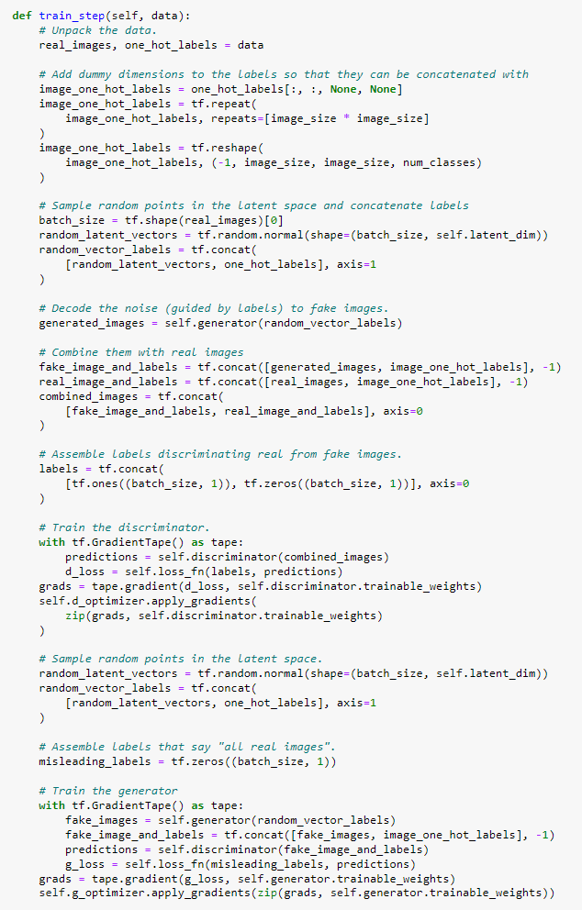
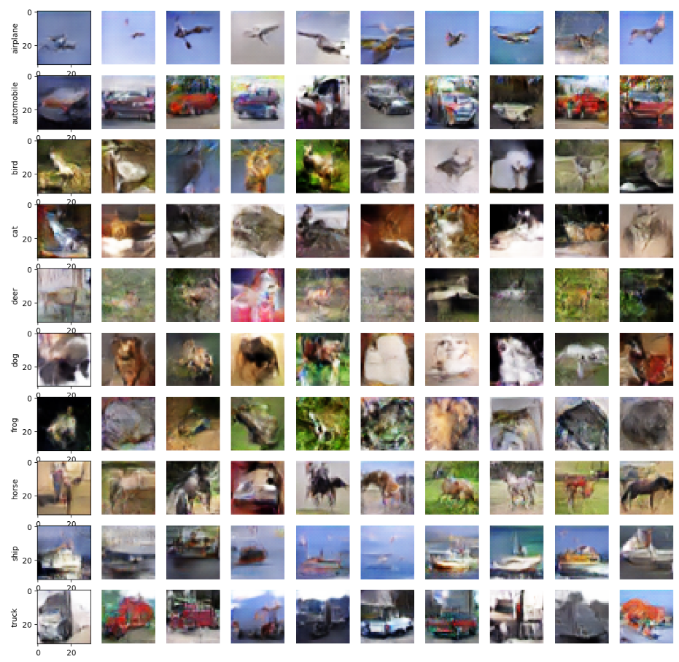
Conditional dcgan: REsults
1. Process images
2. Process class labels
Implementation: Create ConditionalGAN class that inherits from Keras Model class, use GradientTape API to overwrite the training loop process
Results:
After much tuning of parameters:
Achieved FID of 41, decent result, higher (worse) FID than our Unconditional DCGAN , but that is normal because it is easier to train a Unconditional DCGAN
Much room for improvement as seen from images
Some classes like ships and horses have well defined shapes but not much detail
Others have ‘fuzzy’ shapes (unrefined)
Can be much improved with even more tuning/more complex model/architecture
3. Create random noise
4. Generate images
5. Combine with real images
6. Labels for real/fake
7. Train Discriminator
* Update weights via losses
8. Train Generator
* Predict on discriminator to get losses, then update generator weights
Notes:
Convolution: Contains a set of filters (a.k.a kernels) with parameters to be trained
The filters go through the images and creates activation maps (mapping out the features)
Batch Normalisation: Tackles the issue of Internal Covariate Shift
Inputs to a neuron are always changing each epoch
Learning is bottlenecked in deep networks
Max Pooling: Pooling is required to down sample the detection of features in feature maps
Dropout: Randomly drop/ignore some layer outputs , Reduces overfitting

Slide 10
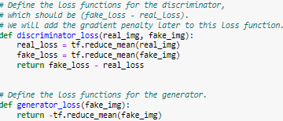
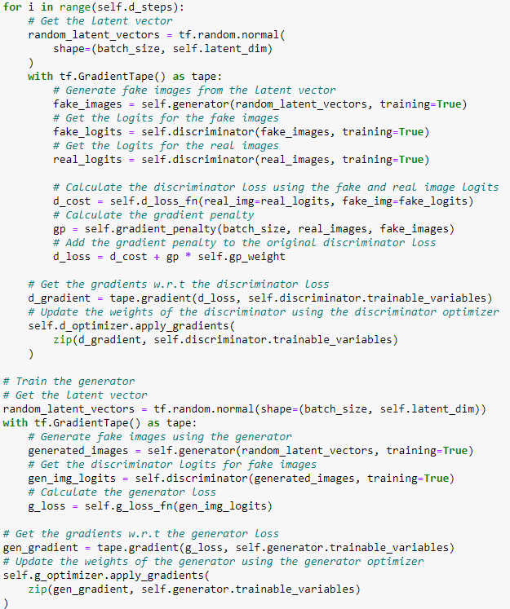
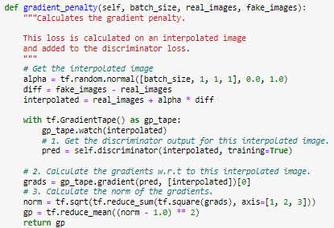
WGAN ARCHITECTURE
Actual Wasserstein’s loss calculation, seems simple as it is simply some mean calculations but the labels must be handled in a specific way such that the calculation is done correctly (gradient penalty is also added to it later)
Training loop
WGAN (Wasserstein Generative Adversarial Network) uses the Wasserstein distance metric to evaluate the performance of the generator. (as the loss)
can give us better potential in our model as it provides a more stable training process
To implement this architecture, we must overhaul our entire training loop/architecture
Wasserstein loss metric is a way of measuring the difference between two sets of data, like comparing 2 drawings. It takes into account all the little bumps and differences to give a more accurate result.
Variants of WGAN architecture are among the top 100 in both unconditional/conditional generation benchmarks on CIFAR10
Implementation: Again, create a custom WGAN keras model class with the following custom methods:
Gradient penalty calculation enforces Lipschitz constraint, (stay closer to real images), stabilizes training
1. Train the discriminator and get the discriminator loss+ gradient penalty
Note: constant weight factor multiplied with gradient penalty
Update discriminator weights
2. Train the generator and get the generator loss
Update generator weights
Notes:
Convolution: Contains a set of filters (a.k.a kernels) with parameters to be trained
The filters go through the images and creates activation maps (mapping out the features)
Batch Normalisation: Tackles the issue of Internal Covariate Shift
Inputs to a neuron are always changing each epoch
Learning is bottlenecked in deep networks
Max Pooling: Pooling is required to down sample the detection of features in feature maps
Dropout: Randomly drop/ignore some layer outputs , Reduces overfitting

Slide 11
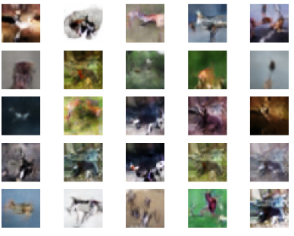
WGAN results
Unfortunately a complex architecture like WGAN is harder to tune, so my final result was slightly worse than my conventional DCGAN implementation
After 200 epochs, achieved FID of ~36 (DCGAN was 32)
From images we can see some sense of repetition in the same patterns reused in some images (e.g. 2 images of turtles but different colours and shading)
Much room to improve with better tuning of parameters and tuning of model architecture itself
After all, benchmarks show that WGAN can achieve very good results <20 or even <10 FID
I decided to perform hyperparameter tuning on model 3 (DCGAN) because it was already my best model so far and tuning seemed to be ‘easier’ as training was faster and I could see improvements in the results more often
Notes:
Convolution: Contains a set of filters (a.k.a kernels) with parameters to be trained
The filters go through the images and creates activation maps (mapping out the features)
Batch Normalisation: Tackles the issue of Internal Covariate Shift
Inputs to a neuron are always changing each epoch
Learning is bottlenecked in deep networks
Max Pooling: Pooling is required to down sample the detection of features in feature maps
Dropout: Randomly drop/ignore some layer outputs , Reduces overfitting

Slide 12
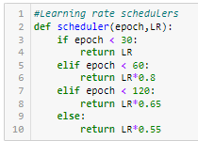
Hyperparameter tuning on model 3 dcgan
Parameters to tune:
Discriminator Learning Rate (dLR)
Generator Learning Rate (gLR)
Kernel Size of Generator Conv layers (k)
Chosen as they have great effect on performance
To save time: run 2 stages of tuning
Stage 1: Kernel size (k) tuning (3 trials)
Stage 2: Discriminator and Generator learning rates (3 trials)
We do the 2 learning rates together because they have a close relationship so its better to test in combinations instead of independently
Slight change in learning rate scheduler to allow a dynamic function for tuning
All other variables kept the same as Model 3
Actual tuning process will be running the training loop for each trial and recording the parameter combination that had the best FID
Stage 1:
We find that the kernel size of 3 performed best
a surprise because higher kernel size usually results in more robustness (all same FID score in results shows that the first trial was best)
Stage 2:
We find that the combination of 0.00015 dLR and 0.00025 gLR performed best
Not a surprise because generally in my previous experience the models most common reason for issues/collapse is due to the discriminator being too strong compared to generator
Having a lower learning rate for discriminator can help the generator to exploit its weaknesses better
However a good balance is still required if not the generator cannot learn much from the weak discriminator
BEST PARAMETERS:
kernel size=3 and 0.00015 dLR and 0.00025 gLR
Notes:
Convolution: Contains a set of filters (a.k.a kernels) with parameters to be trained
The filters go through the images and creates activation maps (mapping out the features)
Batch Normalisation: Tackles the issue of Internal Covariate Shift
Inputs to a neuron are always changing each epoch
Learning is bottlenecked in deep networks
Max Pooling: Pooling is required to down sample the detection of features in feature maps
Dropout: Randomly drop/ignore some layer outputs , Reduces overfitting

Slide 13
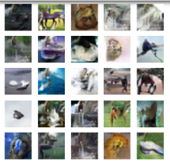
Final model training and evaluation of images
Using the best model from earlier we conduct a final FID test on the full training set (60K images)
Result: 29 FID
Significant improvement from 32 FID
Generated 1000 images in finalImgs folder
Still have room for improvement but good result over all
Conclusion:
I learned how to implement multiple architectures of GAN for image generation like DCGAN, Conditional DCGAN and WGAN.
Learned techniques used to improve the models like different weight initializations and data augmentation
Learned how to do hyperparameter tuning without wasting too much time like a brute force grid search
Notes:
Convolution: Contains a set of filters (a.k.a kernels) with parameters to be trained
The filters go through the images and creates activation maps (mapping out the features)
Batch Normalisation: Tackles the issue of Internal Covariate Shift
Inputs to a neuron are always changing each epoch
Learning is bottlenecked in deep networks
Max Pooling: Pooling is required to down sample the detection of features in feature maps
Dropout: Randomly drop/ignore some layer outputs , Reduces overfitting

Slide 14
Jupyter notebook demo

